Slide 1
Molecular Similarity and its different meanings
Presented by: Christianne Louise Lavin

Slide 2
Introduction
How do we define the word “similar”?
We may all have an idea of what “similar” means, but this may differ from the person sitting next to you.
Similarity is subjective.
The Similarity Property Principle: similar molecules have similar properties.

Slide 3
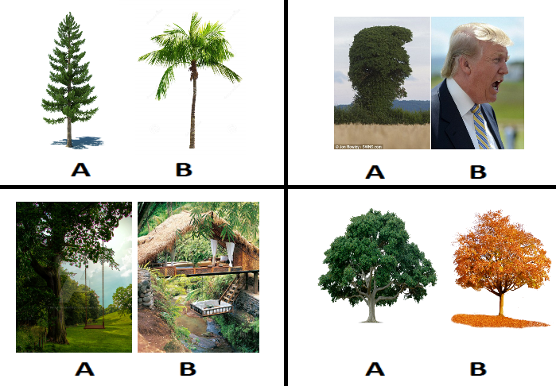
Similarity is subjective
Are photos A similar to photos B?

Slide 4
Molecular Similarity has different meanings
We have to distinguish between:
Chemical Similarity and Molecular Similarity
2D Similarity and 3D Similarity
Molecular Similarity and Biological Similarity
Global Similarity and Local Similarity

Slide 5
Chemical Similarity versus Molecular Similarity
Chemical Similarity
Physicochemical properties
  Solubility
  Boiling point
  Log P
Molecular Similarity
Structural features
  Ring systems
  Shared substructures
  Topologies

Slide 6
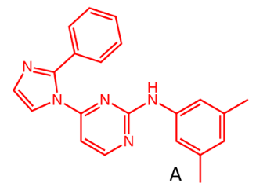
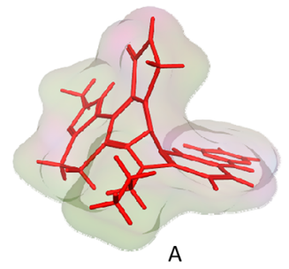
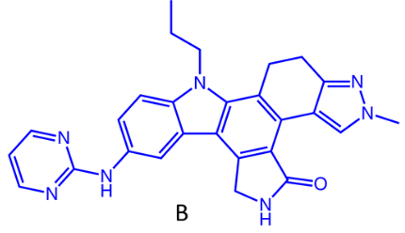
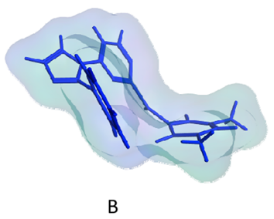
2D Similarity versus 3D Similarity
2D Similarity
Information from molecular graphs
3D Similarity
Based on 3D shape of molecule

Slide 7
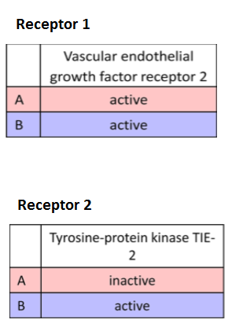
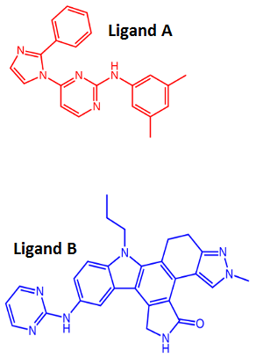
Molecular Similarity versus Biological Similarity
Molecular Similarity
Biological Similarity

Slide 8
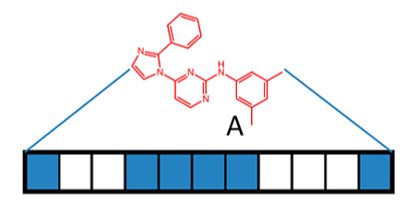
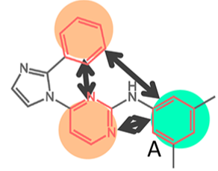
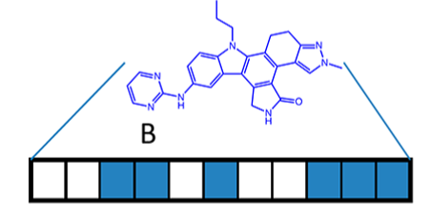
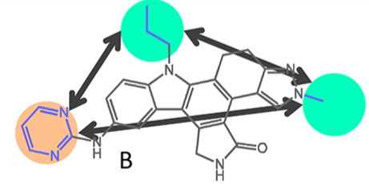
Global Similarity versus Local Similarity
Global Similarity
Comparing the compounds as a whole
Local Similarity
Comparing only selected atoms or groups of each compound

Slide 9
The perspective of a medicinal chemist...
Medicinal Chemists may view similarity based on their experiences
They may take information on chemical reaction of the molecules into account
They would know more about complex similarity-activity relationships

Slide 10
Summary
The meaning of “similarity” may differ from person to person (subjective).
The different meanings of Molecular Similarity have to be acknowledged. → consistency in definitions!
The perspective of a medicinal chemist should also be considered → experience-based!

Slide 11
Thank you!
All images on molecular structures were taken from the paper Molecular Similarity in Medicinal Chemistry, by
Maggiora et al., Journal of Medicinal Chemistry 2014 57 (8), 3186-3204

